Slide 1

Comparing Double Deep Q-Learning and Deep Q-Learning in space invaders
Autonomous and adaptive systems project – Balint Bujtor

Slide 2
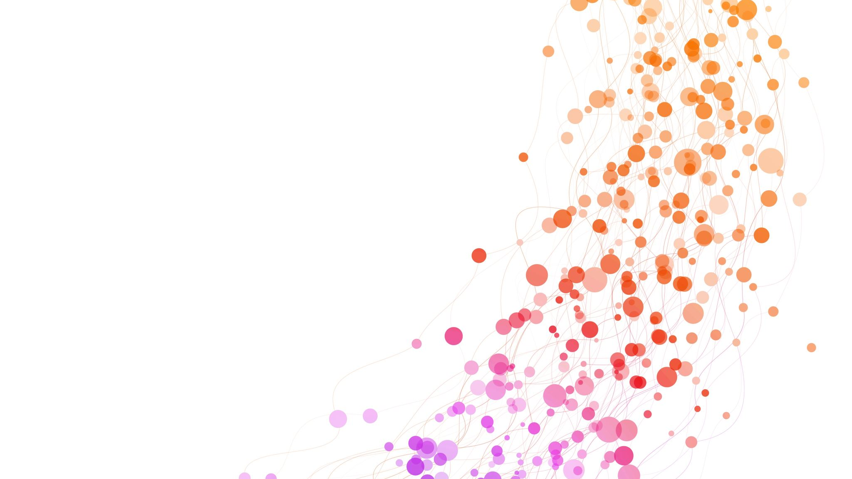
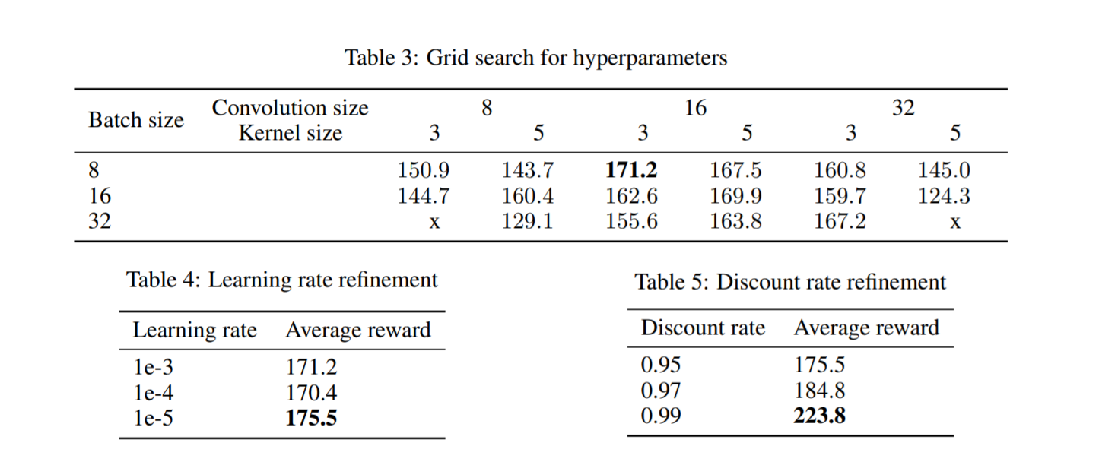
Hyperparameter optimization
Grid search
The parameters optimized:
Batch size: 8, 16, 32
Convolution size: 8, 16, 32
Kernel size: 3, 5
Learning rate: 1e-3, 1e-4, 1e-5
Discount rate: 0.95, 0.97, 0.99

Slide 3

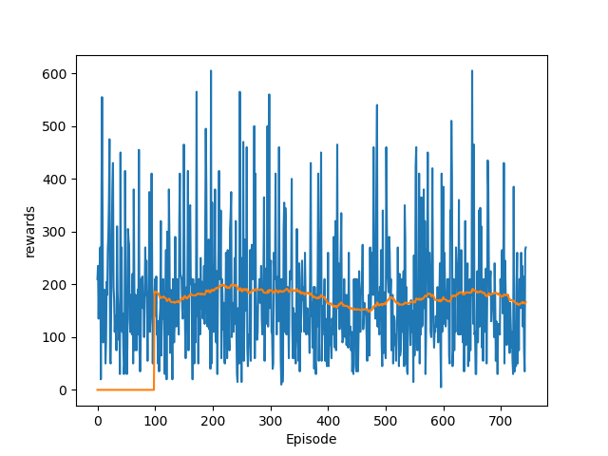
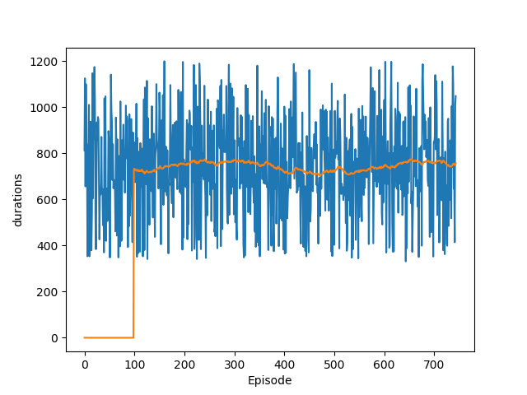
Results using dQN
850 episodes
Average reward: 167

Slide 4
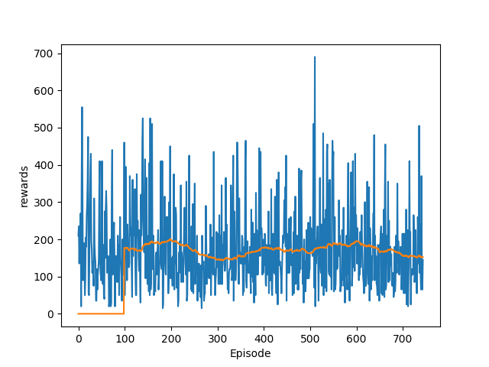
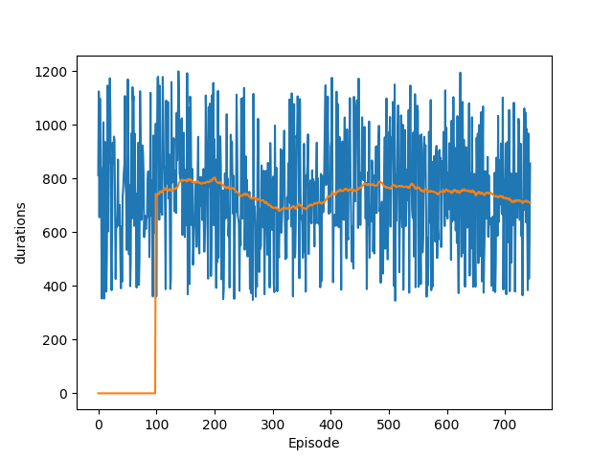
Results using DDQN
850 episodes
Average reward: 152

